Slide 1
International Vegan Rights Alliance Conference:
30 June 2018
Vegan Rights: Access to Plant-Based Food in
Scotland
Barbara Bolton
Barbara Bolton, Go Vegan Scotland, www.goveganscotland.com

Slide 2
“ANIMAL LAW”

Slide 3
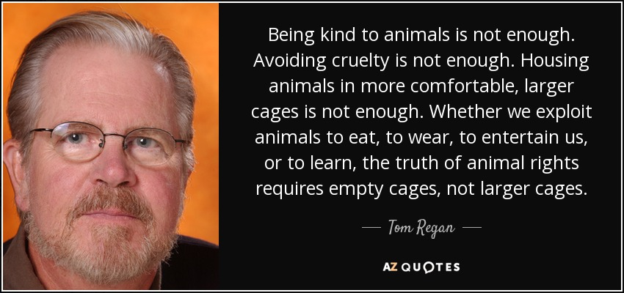

Slide 4
http://www.abolitionistapproach.com/media/slides/theory2.html

Slide 5
“I have no illusions about the usefulness of the legal system…… Anna Charlton, who has taught the animal rights law course with me at Rutgers University for over a decade, often points out that the legal system will never respond differently to animal issues unless and until there is a significant shift in prevailing social consensus about animal exploitation. For the most part, the law reflects social attitudes and does not form them. This is particularly true when the behavior in question is deeply embedded in the cultural fabric, as our exploitation of animals undoubtedly is. As long as most people think that it’s fine to eat animals, use them in experiments, or use them for entertainment purposes, the law is not likely to be a particularly useful tool to help animals.
….. There are some lawyers….. who promote the notion that law will be at the forefront of social change for animals. But these people make a living from practicing law and they are not likely to say otherwise, are they?
……. At this moment, the job of the animal rights lawyer is not to be the primary force for change within the system. As lawyers, we are part of the system that exists to protect property interests. …… In my view, a useful "animal rights" lawyer is a criminal lawyer one day, helping activists who are charged with civil disobedience; an administrative lawyer the next day, helping activists obtain permits for demonstrations; and a constitutional lawyer the next day, helping students who do not want to vivisect as part of their course work, or helping prisoners who want vegan food.”

Slide 6
ANIMAL WELFARE

Slide 7
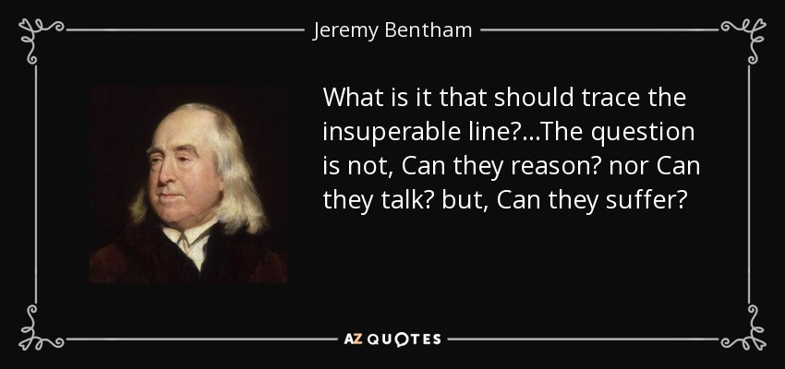

Slide 8
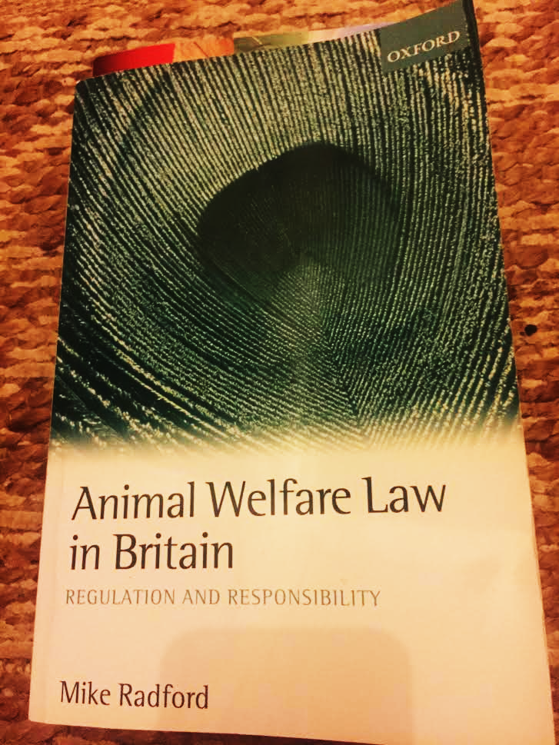

Slide 9
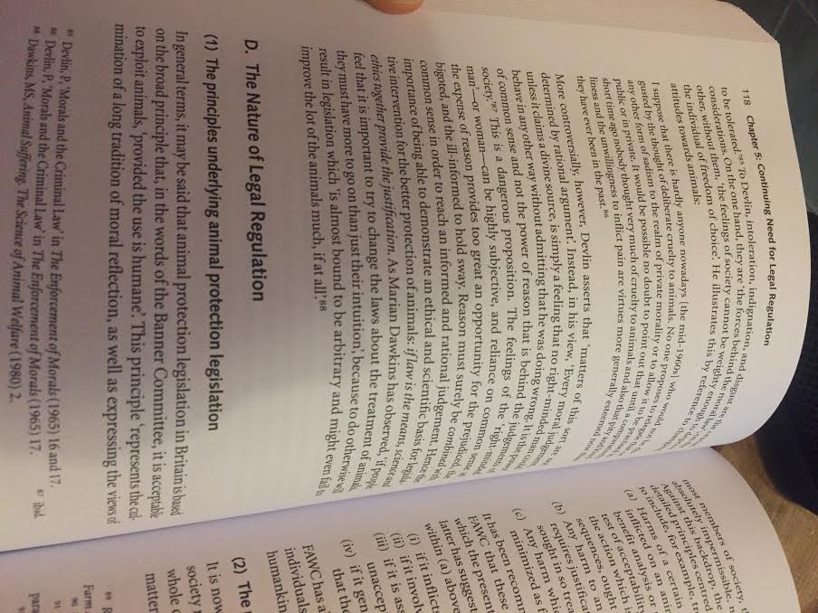
“In general terms, it may be said that animal protection legislation in Britain is based on the broad principle that …it is acceptable to exploit animals, ‘provided the use is humane’.”

Slide 10
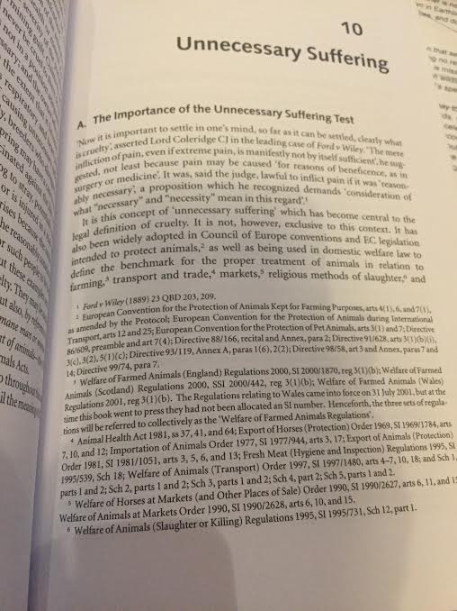
Unnecessary suffering: “Death is not itself sufficient”
Unnecessary Suffering:
“The mere infliction of pain, even if extreme pain, is manifestly not by itself sufficient…[it is] lawful to inflict pain if it was ‘reasonably necessary’…
“The term ‘unnecessary suffering’ does not always require that animals be treated in the way which causes them the least possible suffering. The relevant test is that an animal is not caused to suffer unnecessarily by the standards of the legislatively sanctioned practice which has been adopted.”

Slide 11
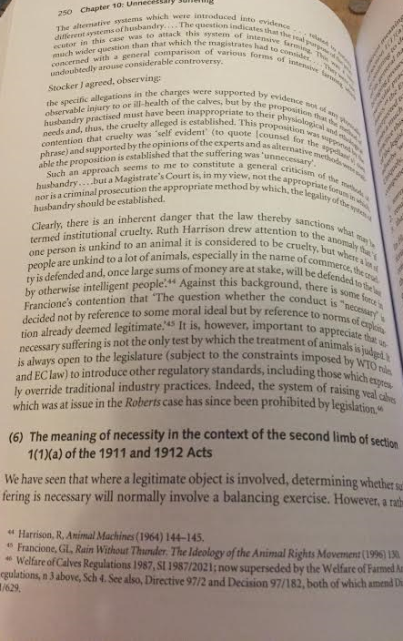
“Against this background, there is some force in Francione’s contention that “The question whether the conduct is “necessary” is decided not by reference to some moral ideal but by reference to norms of exploitation already deemed legitimate.”

Slide 12
http://abolitionistapproach.com/media/slides/theory2.html

Slide 13
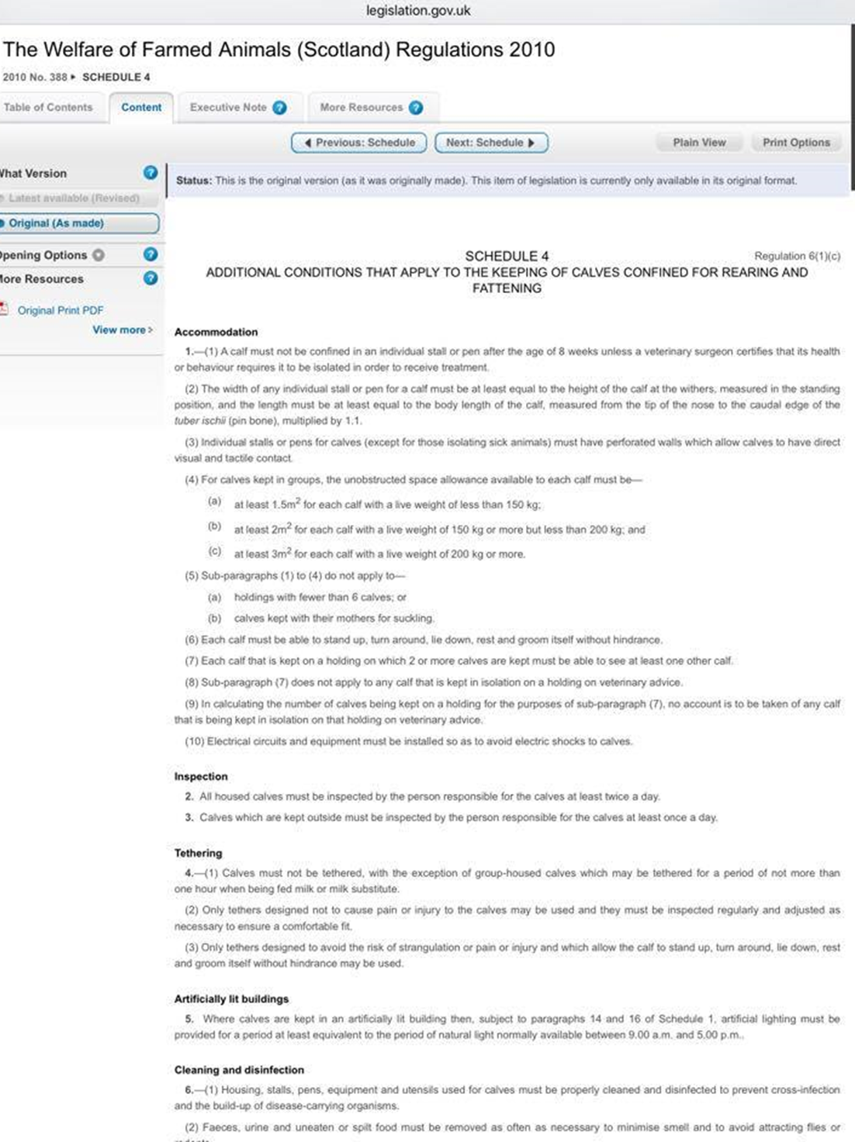
What we don’t do - Welfarism
“Calves confined for rearing and fattening”
“A calf must not be confined to an individual stall or pen after the age of 8 weeks unless a veterinary surgeon certified that its health or behaviour requires it to be isolated in order to receive treatment.

Slide 14
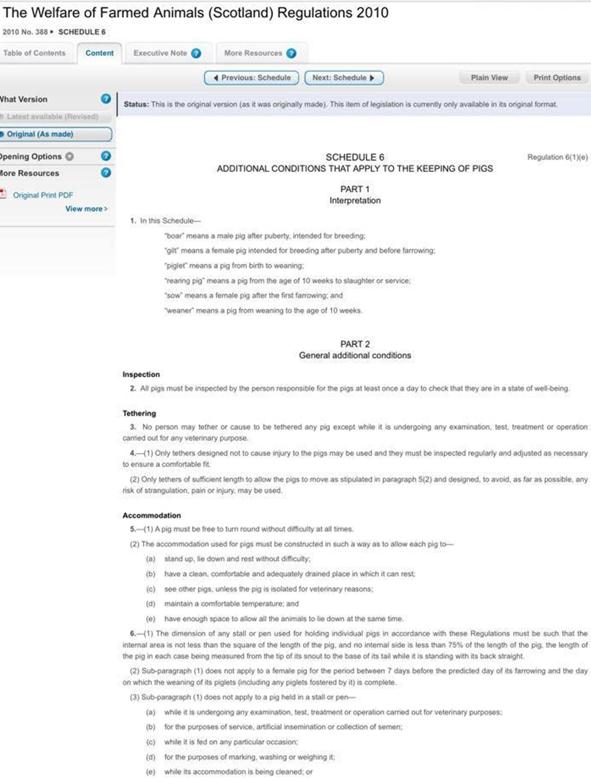
“The dimension of any stall or pen used for holding individual pigs in accordance with these Regulations must be such that the internal area is not less than the square of the length of the pig, and no internal side is less than 75% of the length of the pig…”

Slide 15
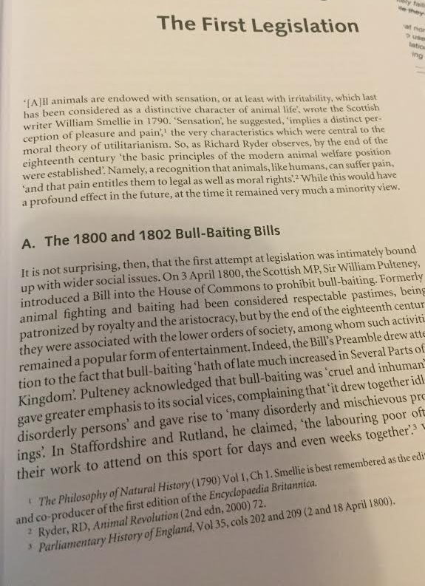
We’ve been regulating the exploitation of animals for hundreds of years.
Perhaps, had we not had welfare laws, we would instead have had a vegan world.

Slide 16
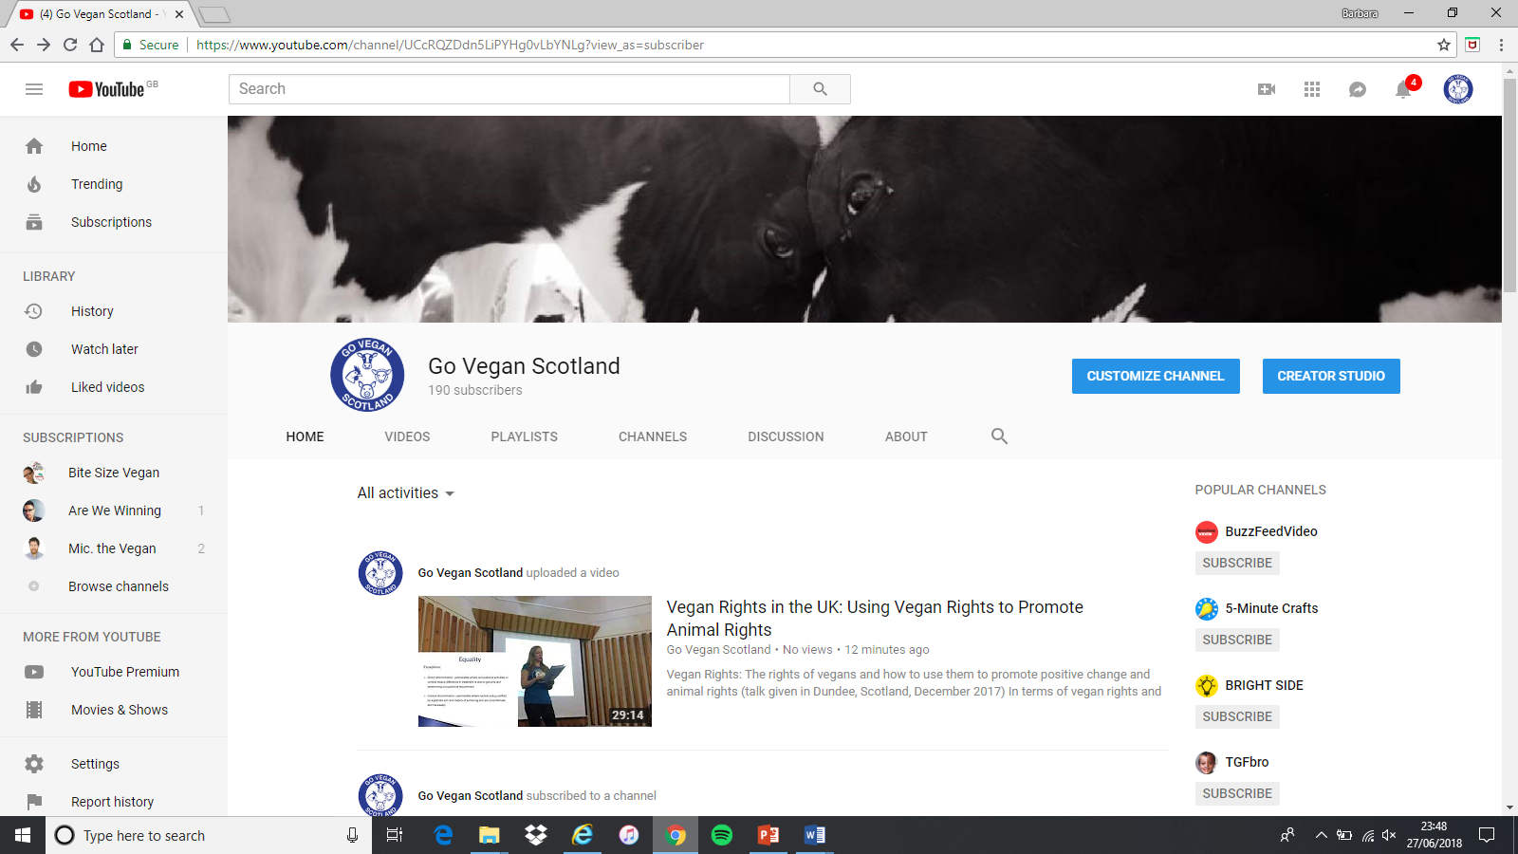
Vegan Rights in the UK:

Slide 17
Vegan Rights in the UK:
Promoting Animal Liberation Using Vegan Rights

Slide 18
Paintings by Misty’s Art for Animals: Portraits of rescued animals who live at vegan run Tribe Animal Sanctuary Scotland (TASS)

Slide 19
Vegan Rights
Vegans have rights or protections under:
International human rights treaties
European Convention on Human Rights
European Equality Framework
UK Implementing Legislation (Human Rights Act and Equality Act)

Slide 20
Freedom of thought, conscience and belief
right to act in accordance with protected conviction that it is wrong to use and kill other animals unnecessarily
restrictions must be necessary and proportionate
positive duty on State to take such steps as are necessary to secure to us these rights
protected from discrimination on account of our vegan convictions, in employment, education, and public and private service provision

Slide 21
Results of GVS Survey into Vegan Provision in State Entities
https://www.goveganscotland.com/living-vegan

Slide 22
Vegan patients cited examples of:
being denied access to suitable food / force-fed animal products against their fundamental convictions
recovering from operations / childbirth and unable to eat due to lack of suitable food
going without food for days / discharging themselves early due to lack of suitable food
relying on food brought by families/ visitors, in some cases refused permission to bring in suitable food
pressure on patients to eat animal products
subjected to derogatory comments / inaccurate nutritional information from medical professionals

Slide 23
Vegans parents, pupils or students cited examples of:
children missing out on free meals because of lack of suitable options
schools advising that they do not provide food suitable for vegans
teaching staff mocking the ethics of pupils and students
bias in teaching with promotion of use and killing of animals by animal-use industries
children being denied the opportunity to cook vegan alternatives in home economics

Slide 24
Vegans State employees cited examples of:
staff avoiding meetings and training events because of the lack of suitable food options
no suitable options in canteens, belittled when asked about
no provision for vegans in the military or police
Other issues included:
lack of vegan options in prison or police custody and bullying by police
lack of vegan options on jury duty and court premises

Slide 25
We called on the Scottish Government to:
ensure good suitable food is available at all times in all state entities (hospitals, schools, prisons etc)
educate public sector workers on the meaning of veganism and its legal status
promote plant-based nutrition education for medical professionals and in schools
Full submission available on our website under Living Vegan (www.goveganscotland.com)

Slide 26
“As you say in your email, veganism is a moral conviction/belief that it is wrong to subjugate, exploit and kill non-human animals and it is considered wrong to use them as commodities therefore, as far as they possibly can, vegans avoid any involvement in the use and killing of animals.”

Slide 27
“individual public authorities would be required to ensure that they make reasonable adjustments to meet the needs of people with protected characteristics.”
“It is however the responsibility of individual organisations to comply with the requirements of the Equality Act 2010 and it is not within the gift of the Scottish Government to enforce them.”

Slide 28
Next Steps
Freedom of Information requests to local authorities
Recover documents showing:
policies on educating staff on veganism (if such exist)
plant-based menus / options on menus
Looking at lack of joined up approach – e.g. NHS recognition of plant-based diet / local authority food caterers misunderstanding

Slide 29
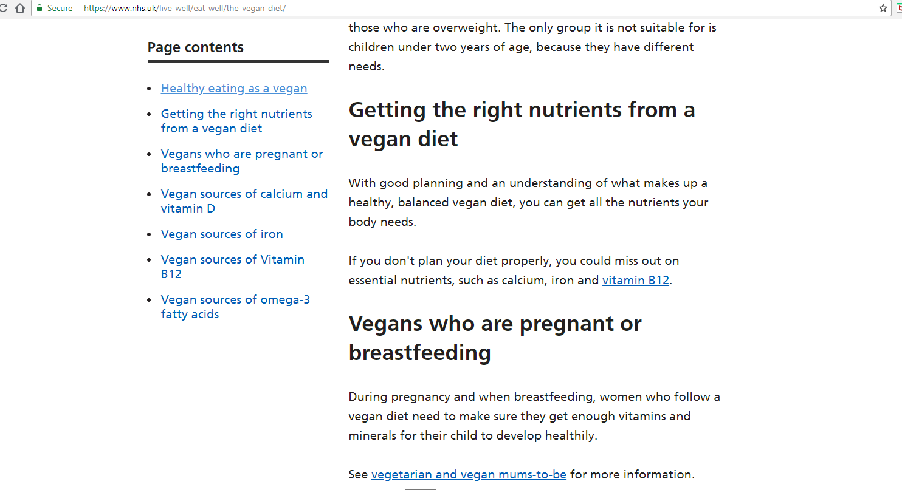

Slide 30
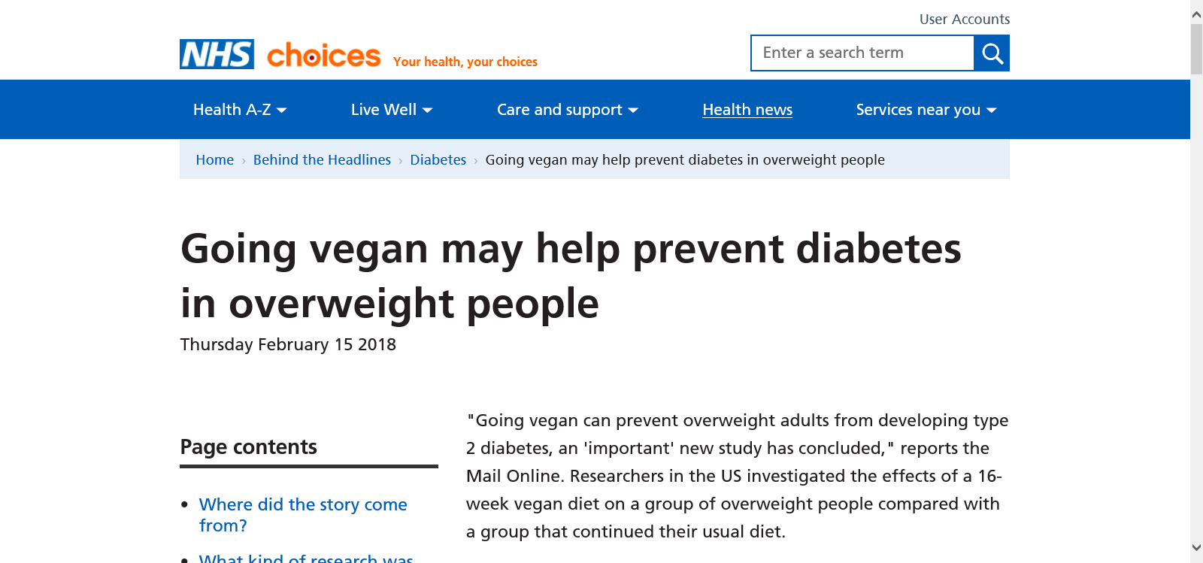

Slide 31
Next Steps Cont’d:
Plant-based nutrition for medical practitioners

Slide 32
Next Steps Cont’d:
Submission to Consultation on Diet, Weight and Health – www.goveganscotland/living-vegan.com

Slide 33
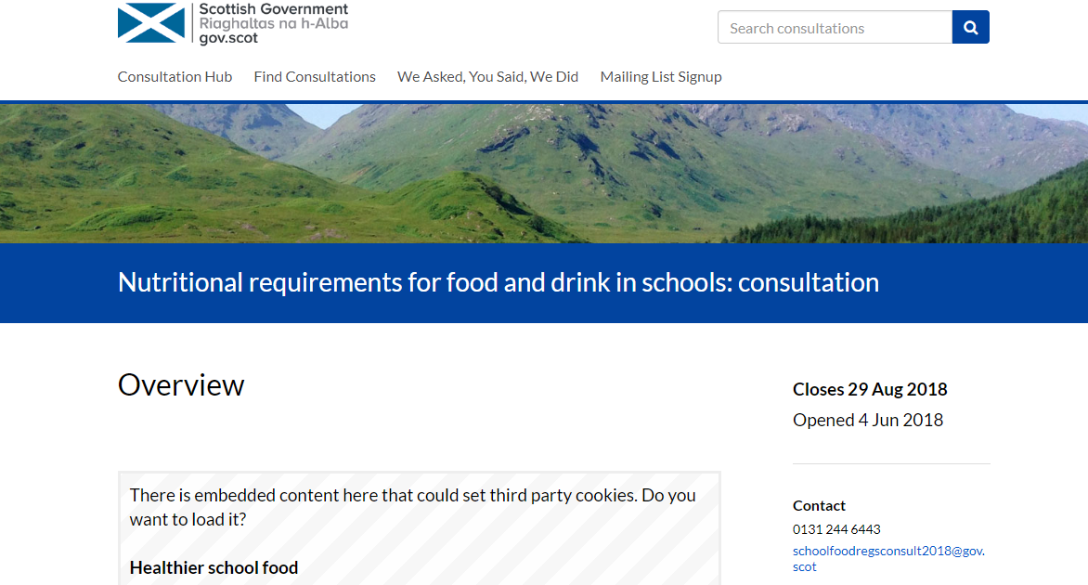
Next Steps Cont’d:
Consultation on Nutritional Requirements for School Food and Drink

Slide 34
Next Steps Cont’d:
Good Food Nation Bill

Slide 35
